Slide 1
Shadamoro Jeremiah (AUL/CMP/22/082) Olofu Possible (AUL/IFT/22/009) Supervisor: Dr. Babalola Asegunloluwa Department of Computing Anchor University Lagos August 2026
FRESCO
A Fruit Freshness and Shelf-Life Estimation Platform
An Intelligent Shelf-Life Food Estimation System.

Slide 2
The Problem: Food Waste
Why It Happens
❌ People lack reliable information about food condition
❌ Most fresh fruits have no expiration date at all
❌ Sensory inspection is subjective and unreliable

Slide 3
What Makes Freshness Assessment Difficult?
Problem 1: Subjective Assessment
❌ Consumers rely on sight, touch, and smell
❌ Two people looking at the same fruit reach different conclusions
❌ Visible mould means contamination started 1-2 days earlier.
Problem 2: Ignorance of Storage Interactions
❌ Bananas produce ethylene gas that spoils nearby fruits faster
❌ Storing bananas with strawberries reduces shelf life by 2-3 days
❌ Consumers are unaware of these invisible interactions
Problem 3: Inaccessible Solutions
❌ Accurate systems require expensive sensors and cameras
❌ Hyperspectral imaging costs tens of thousands of dollars
❌ IoT sensor systems are impractical for households

Slide 4
A Smartphone-Based Freshness Assessment System
What FRESCO Does
✅ Identifies fruit type from a photograph
✅ Assesses visual freshness on a 0–1 scale
✅ Estimates remaining shelf life in days
✅ Warns about storage conflicts (ethylene)
✅ Recommends best storage method
✅ Tracks personal fruit inventory
Key Feature: Accessibility
No extra hardware required
Just a smartphone camera

Slide 5
Aim & ObjectivesAim & Objectives
 | Objective
1 | Develop fruit identification using MobileNetV2 transfer learning.
2 | Implement continuous freshness scoring (0.0–1.0).
3 | Build shelf-life estimation engine using curated fruit data.
4 | Deliver as Progressive Web : Application with inventory and ethylene checking.
Aim
To design, develop, and implement a mobile-first web application that estimates fruit freshness and shelf life using only a smartphone camera.
.

Slide 6
Methodology
Phase 1: Literature Review
Review computer vision, transfer learning, post-harvest biology
Identify datasets: Fruits-360, Kaggle Fresh/Stale
Phase 2: Architecture Design
Three-tier: Frontend (Next.js) → Backend (FastAPI) → Database (PostgreSQL)
Seven-step scan pipeline
Phase 3: Implementation
> Train MobileNetV2 on Google Colab
> Build full-stack application
Phase 4: Testing
> Evaluate accuracy on held-out test set
> Validate shelf-life estimates

Slide 7
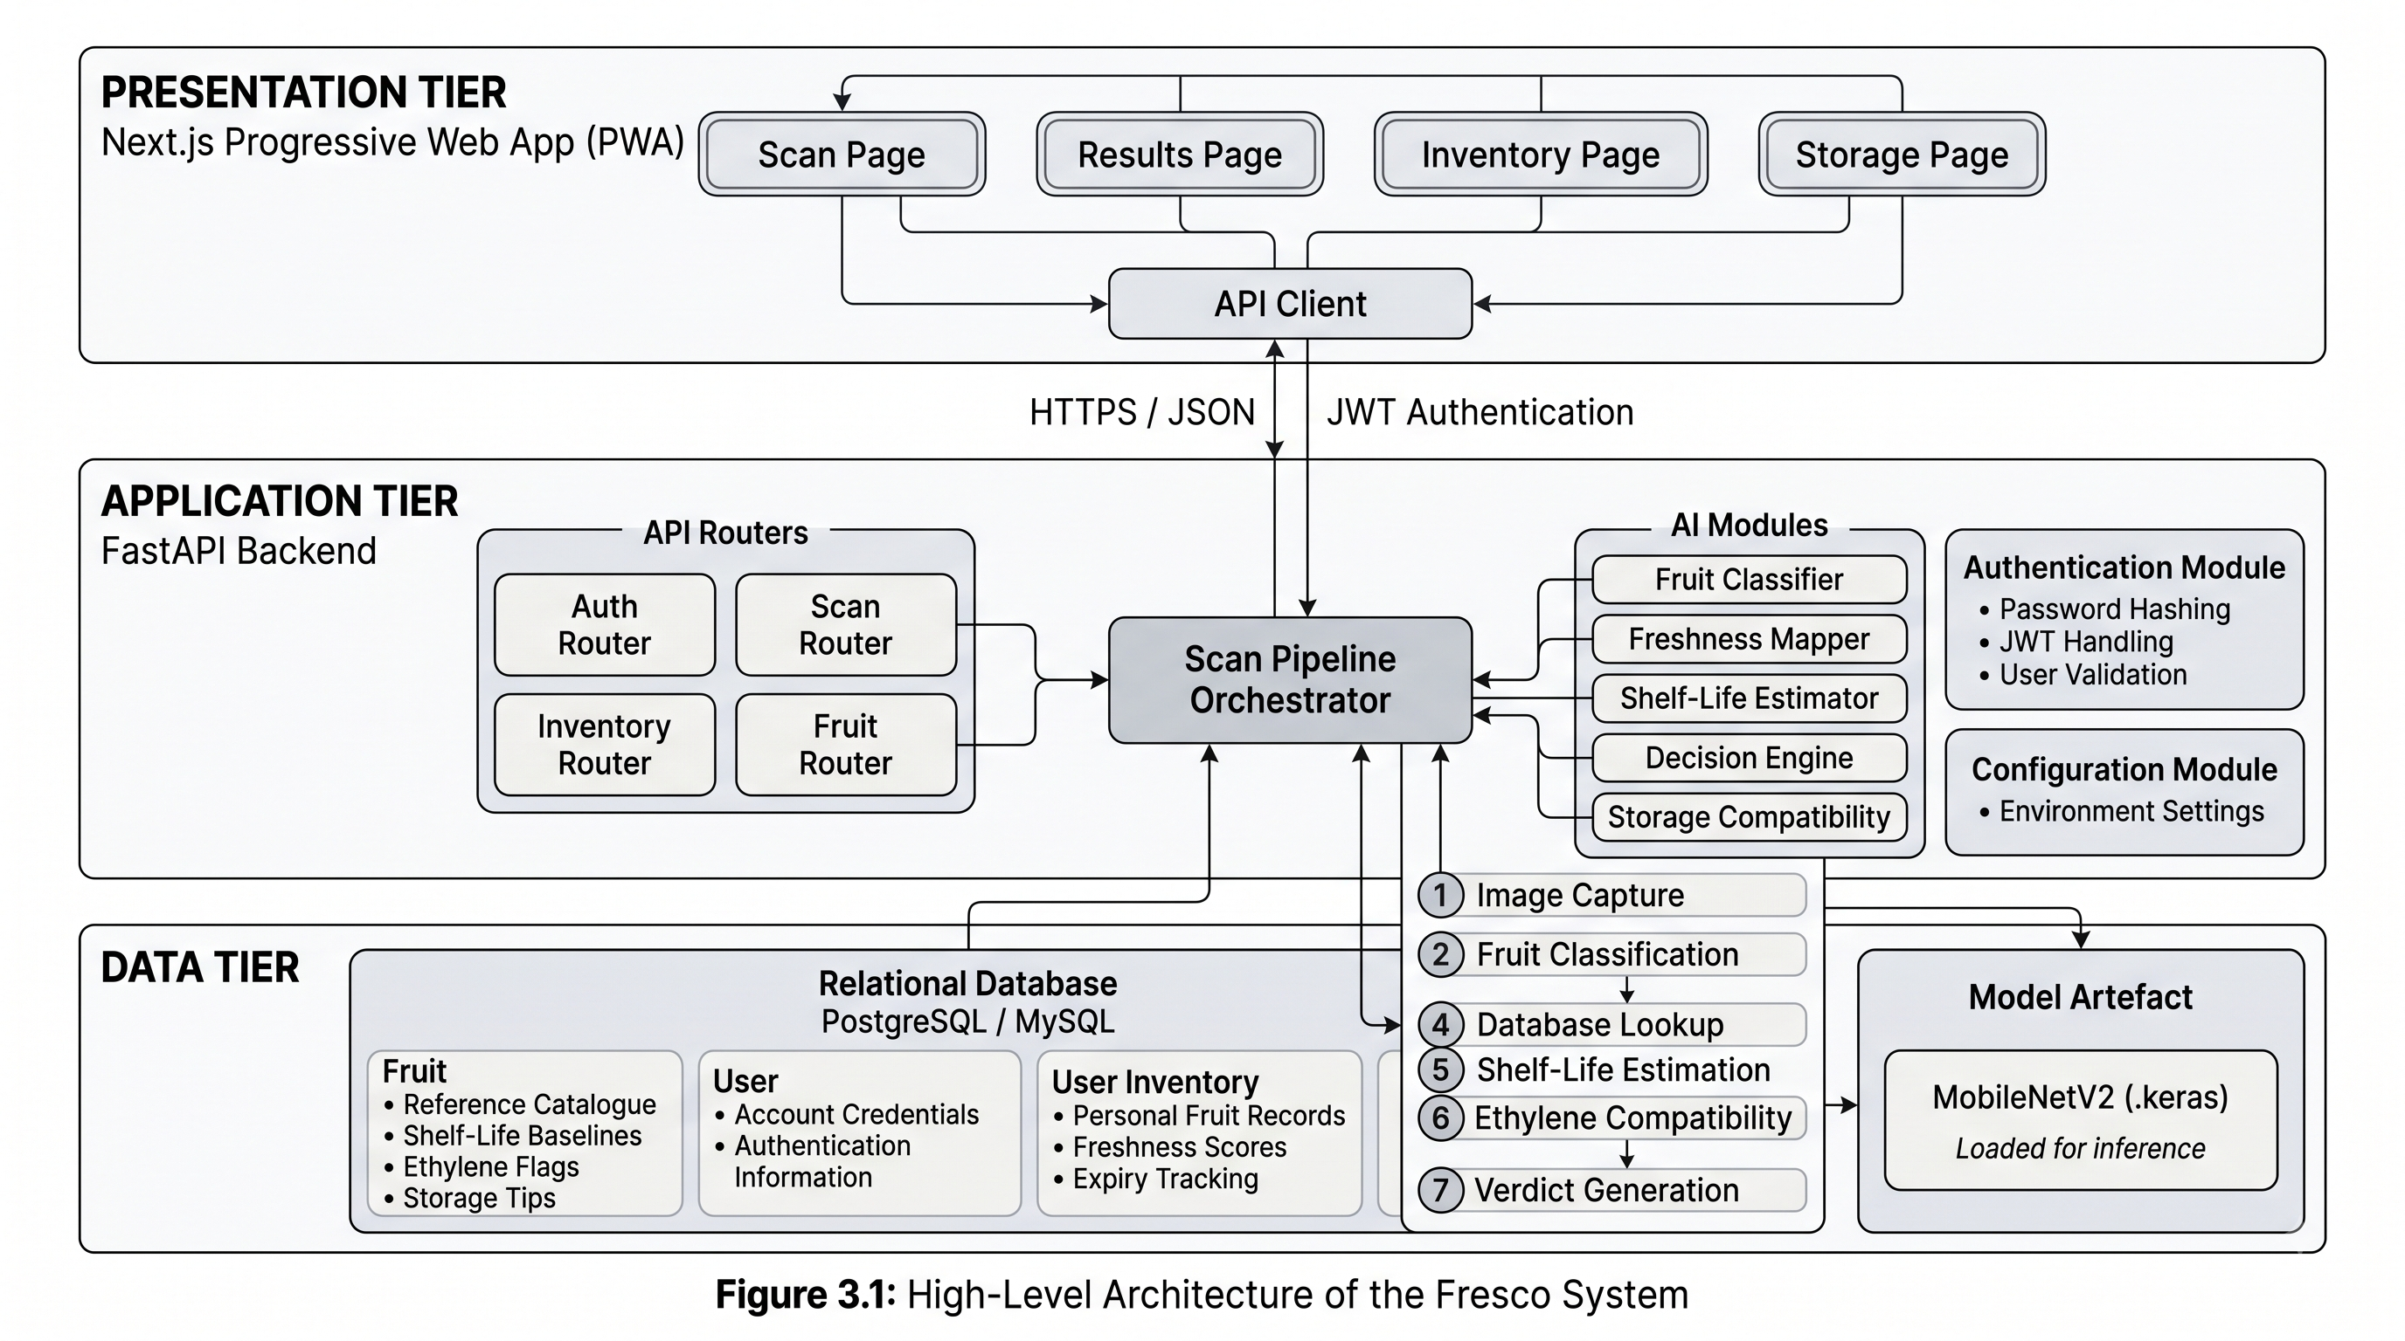
System Architecture

Slide 8
Five Freshness Categories
Score Range | Category | Action
0.80 – 1.00 | Fresh | Normal storage
0.60 – 0.79 | Slightly Aged | Eat soon
0.40 – 0.59 | Aging | Use within 1-2 days
0.20 – 0.39 | Old | Consume immediately
0.00 – 0.19 | Spoiled | Discard
.

Slide 9
Results & Conclusion
Classifier Performance
✅ 89.3% top-1 accuracy on held-out test set
✅ 97.5% top-3 accuracy
✅ 200–500ms inference latency (after warm-up)
Key Strengths
✅ Hardware Accessibility: Works on any smartphone
✅ Ethylene Awareness: First consumer-facing implementation
✅ Interpretable: Clear recommendations with explanations
✅ Installable: No app store required (PWA)

Slide 10
Limitations
❌ Classifier covers 4 fruit types automatically (Apple, Banana, Carrot, Tomato)
❌ 38 fruits supported via manual selection
❌ Lighting sensitivity (known CNN limitation)
❌ No real-time environmental sensing

